Slide 1







2022
WebGIS Training in QGIS
UINSHJ | UT | DR. Sodikin | Dr. Edy Trihatmoko
10 September 2022

Slide 2
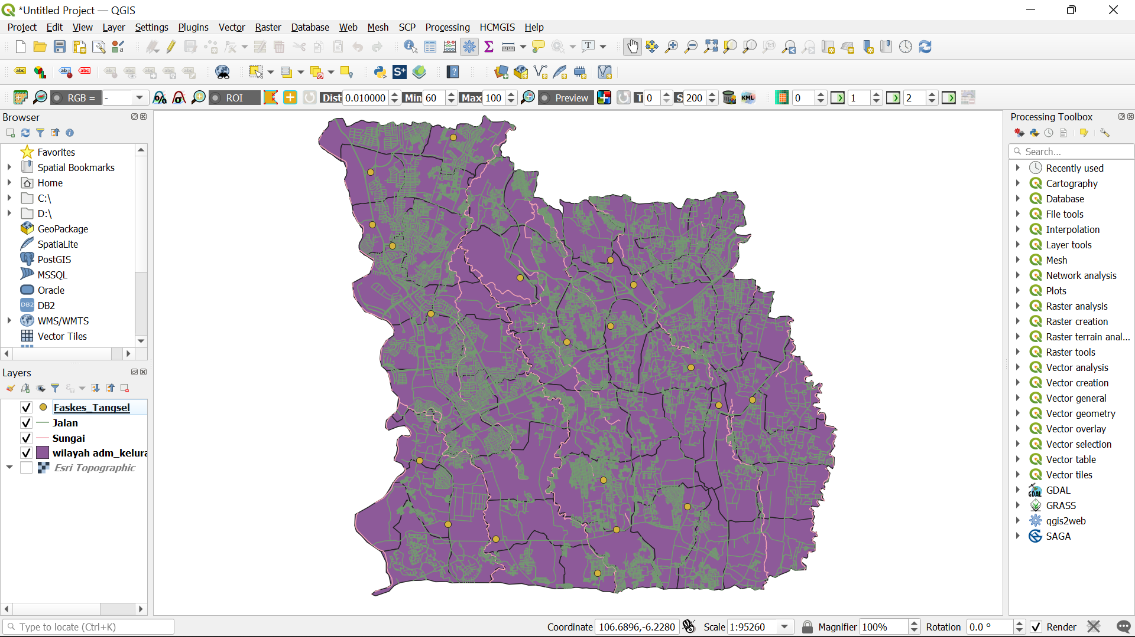

1. Add tool web from plugins
2. Add tool HCMGIS from plugins

Slide 3
3. Drag all the content from the folder

Slide 4
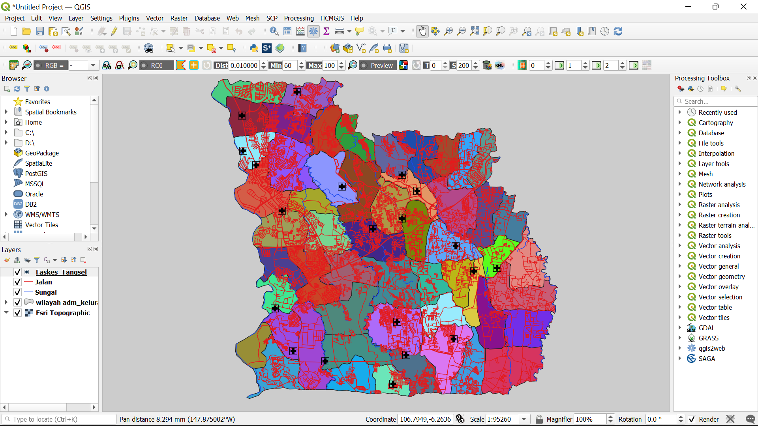
4. Try to change the symbology by changing the color and symbols

Slide 5
5. Put base map from the HCMGIS tool

Slide 6
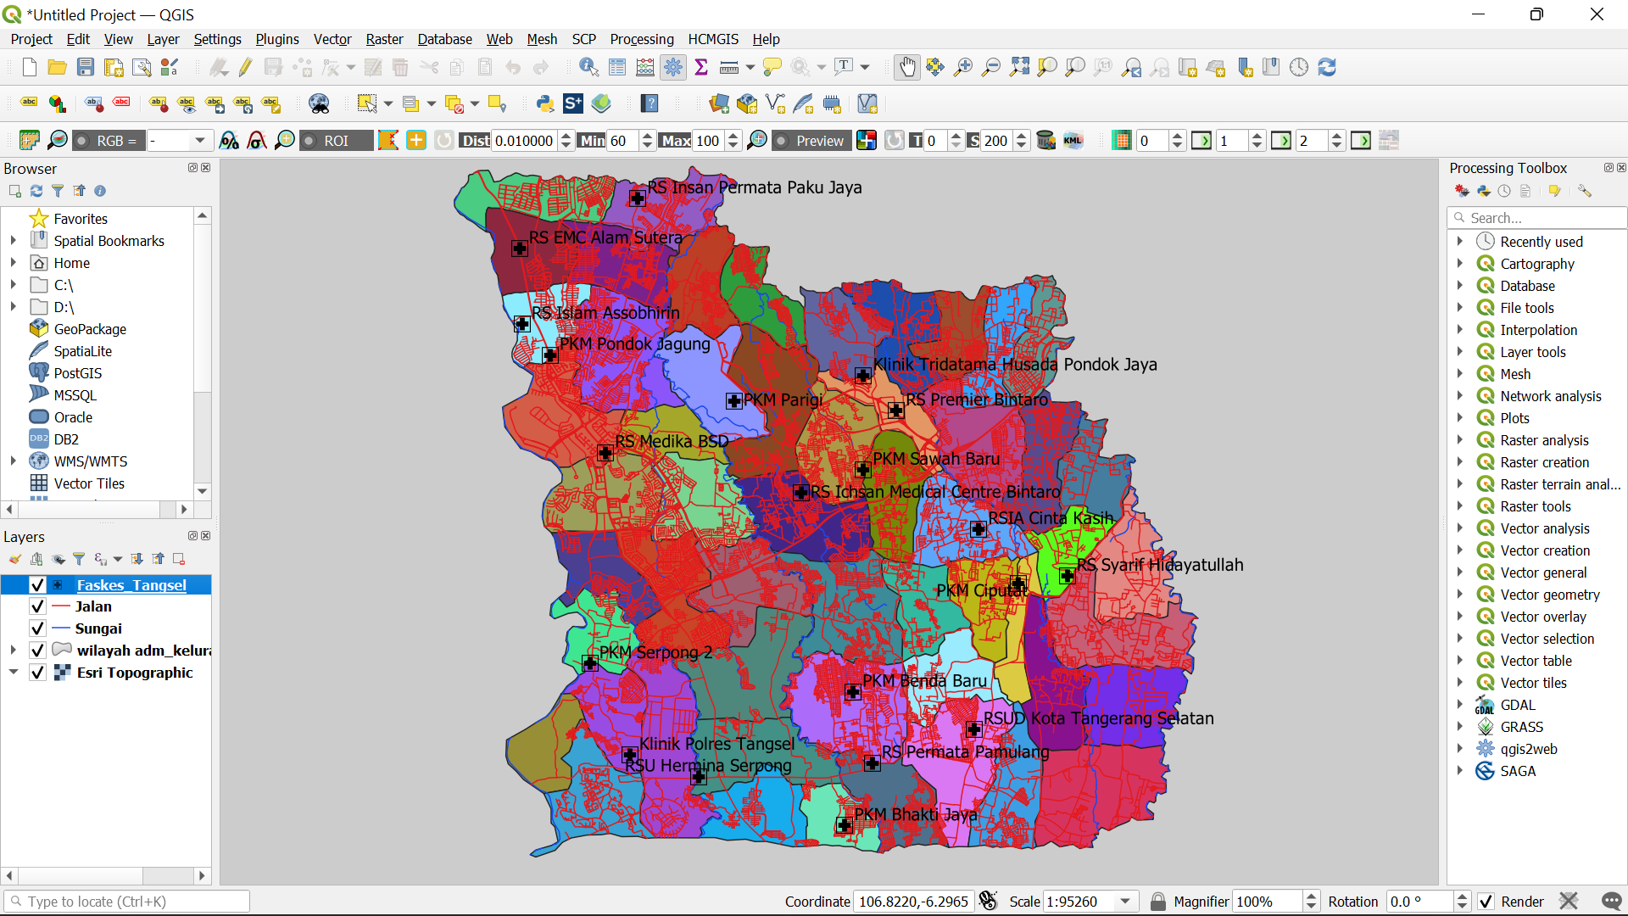
6. Don’t forget to put labels on your symbols

Slide 7
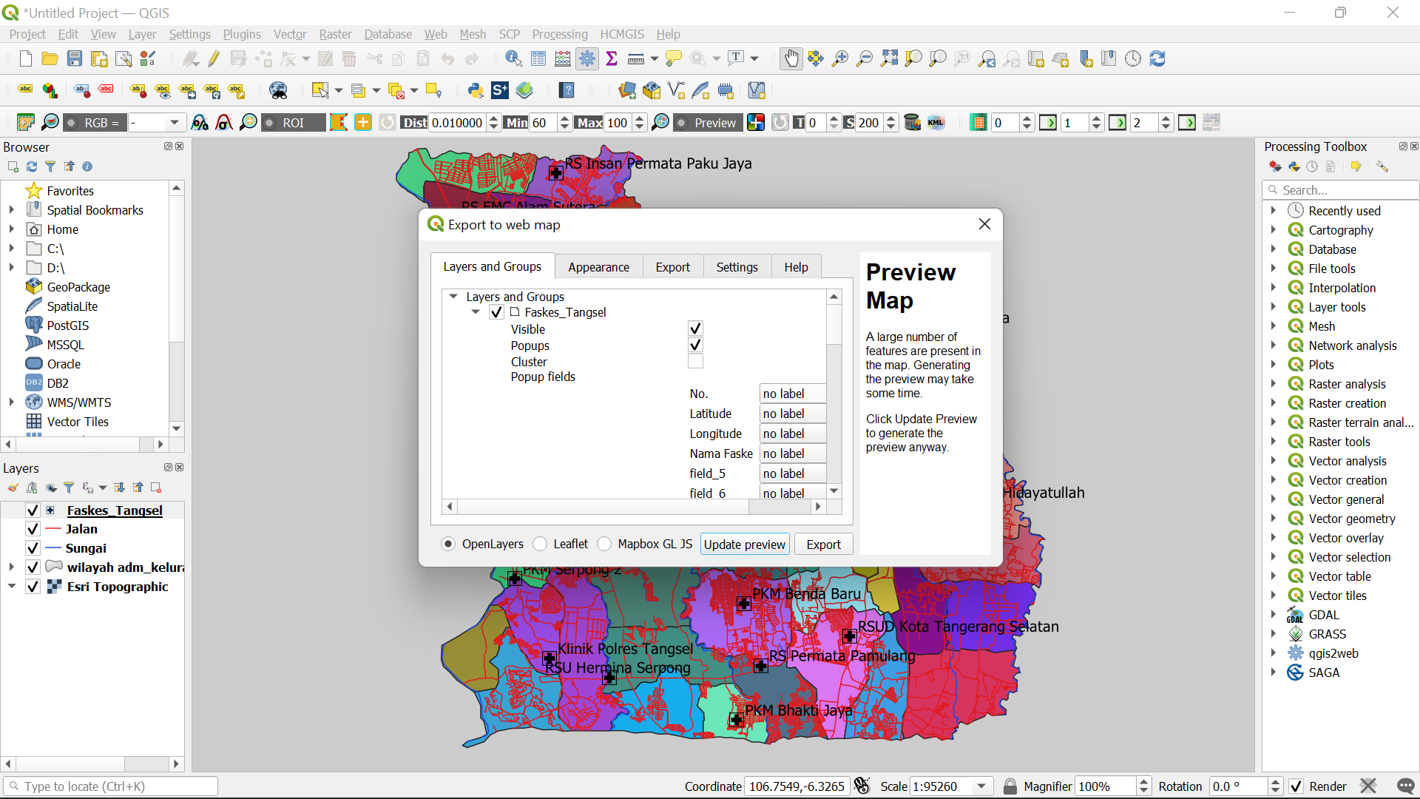
7. Open qgisweb and the window will be opened

Slide 8
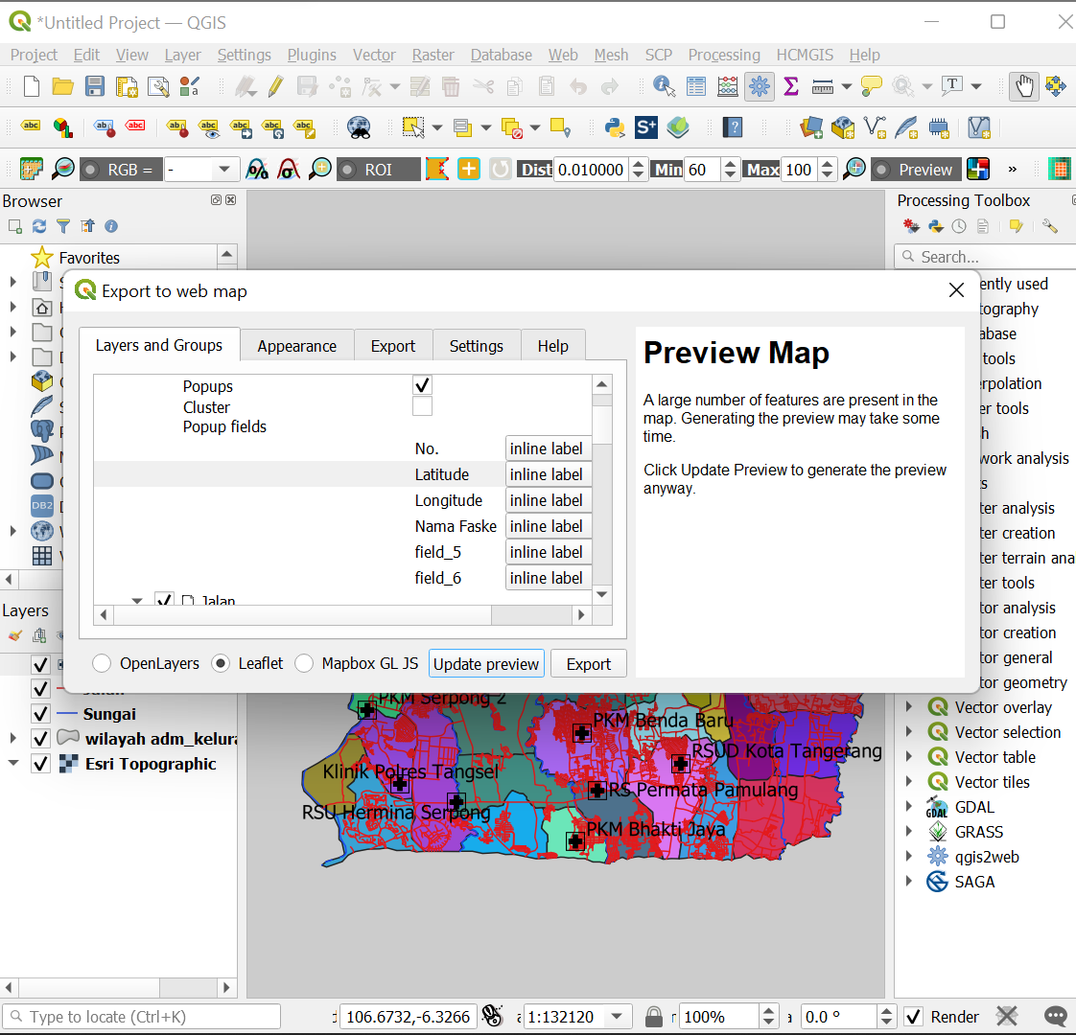
8. Open qgisweb and the window will be opened, click leaflet instead of OpenLayers on the bottom of the window.

Slide 9
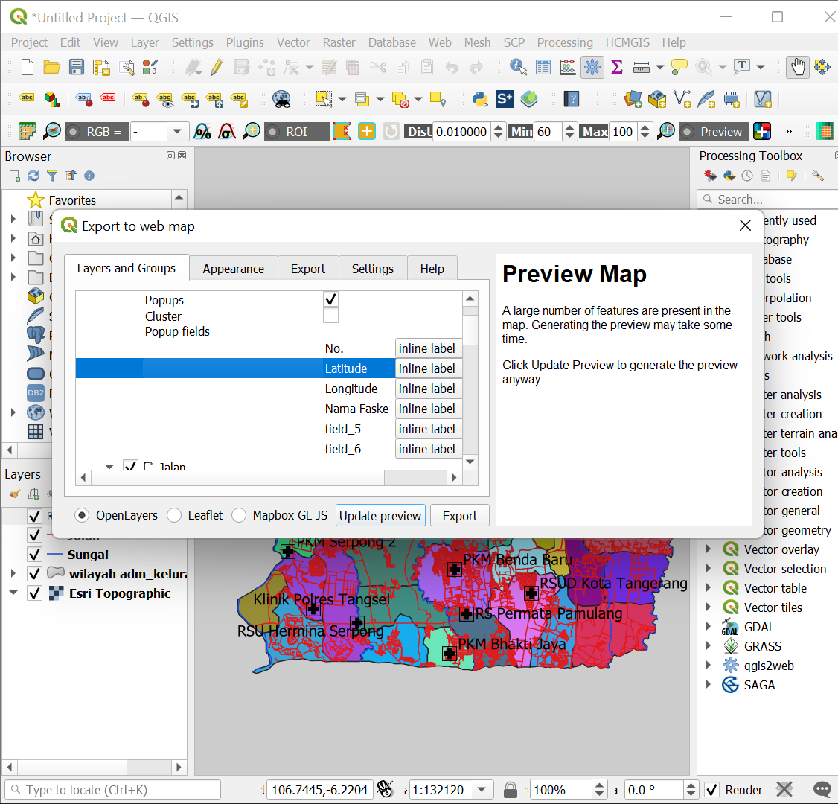
9. Change “no label” to “inline label” for all the coloumns

Slide 10
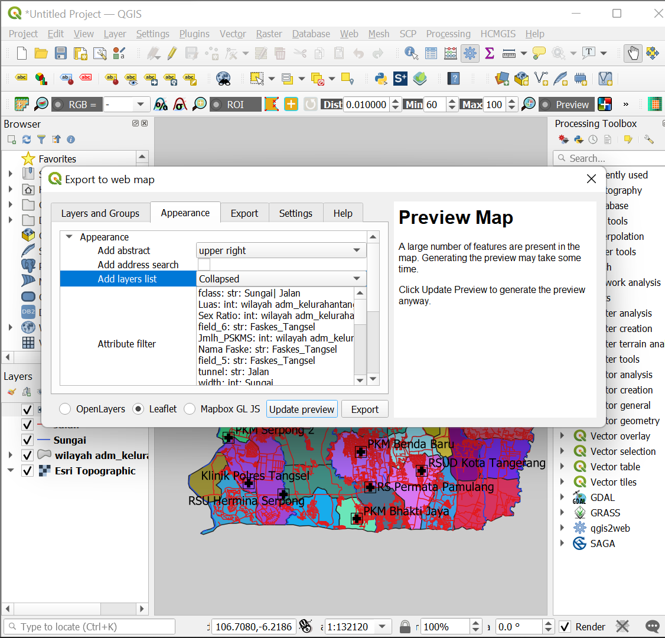
10. Change add abstract to “upper right” and add layer list to “collapased”

Slide 11
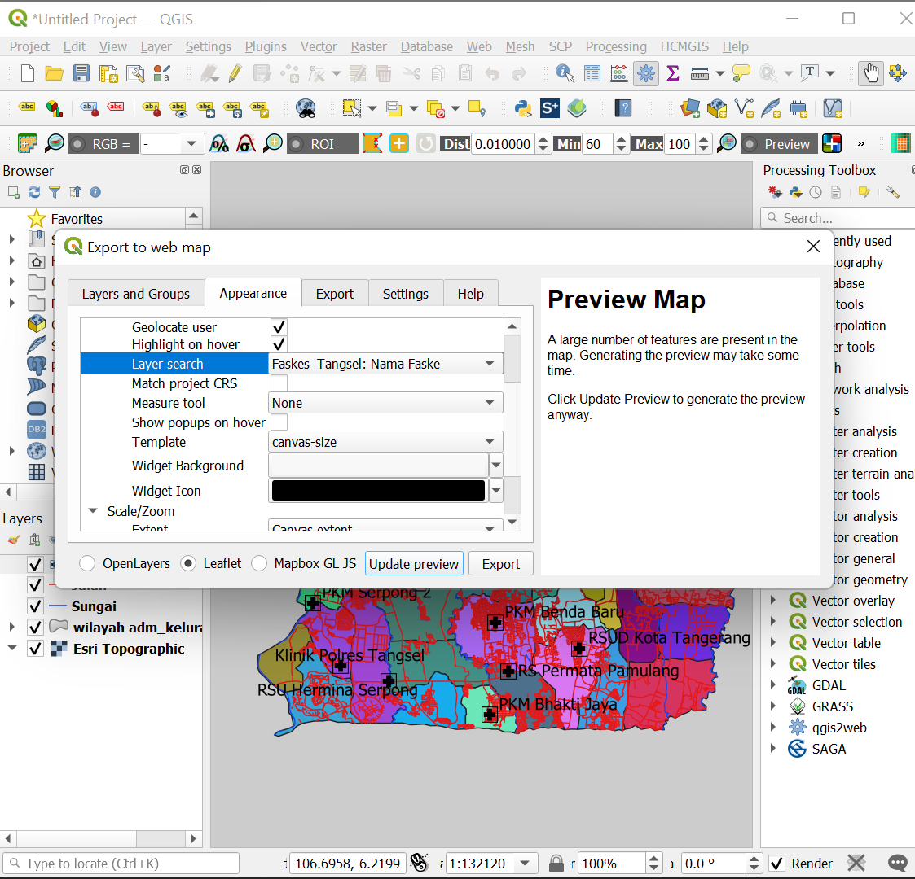
11. ‘check’ the geolocate user and highlight on hover.

Slide 12
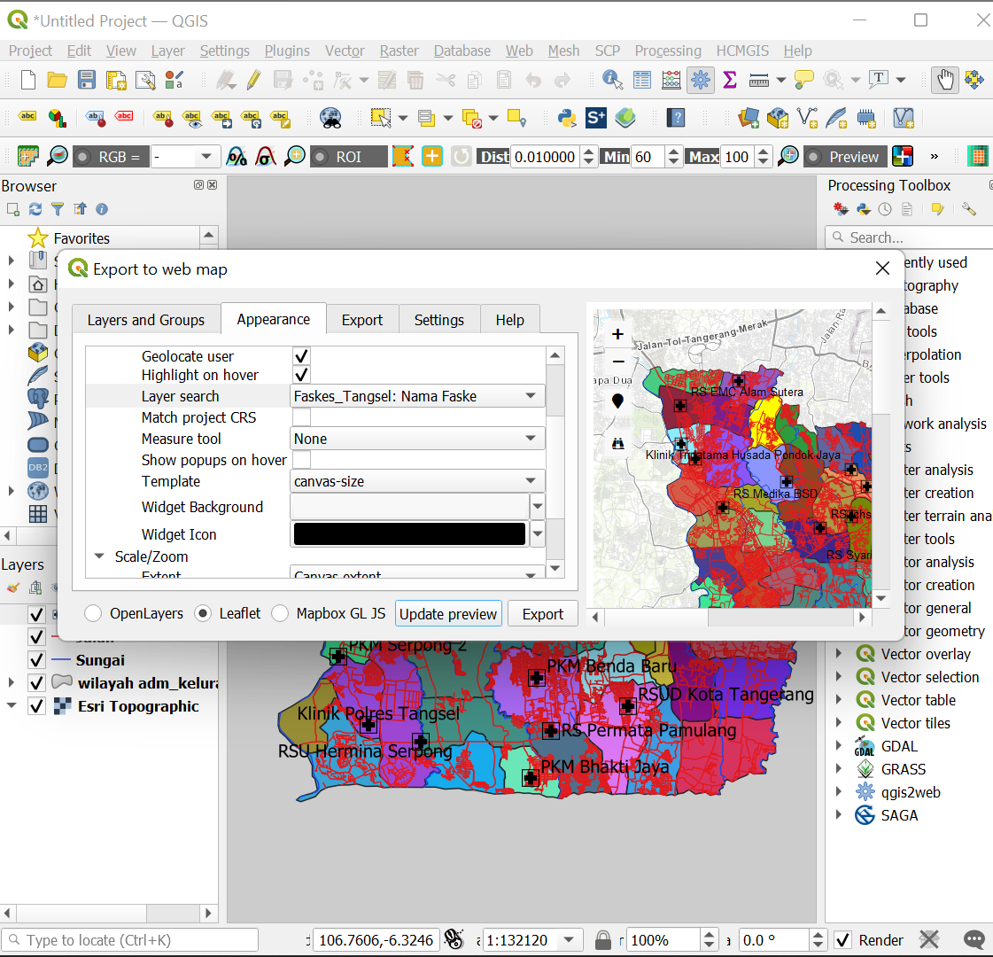
12. Click update review.

Slide 13
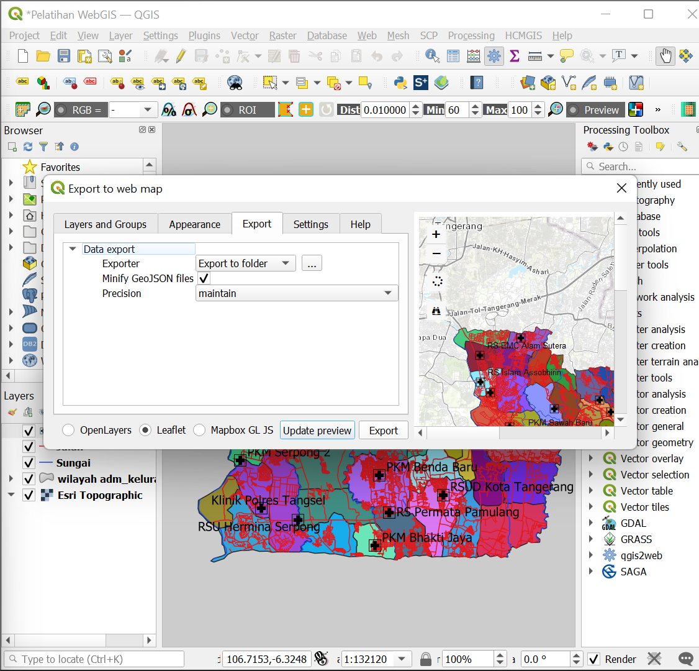
13. Choose the export bar and find the export folder to save the file.

Slide 14
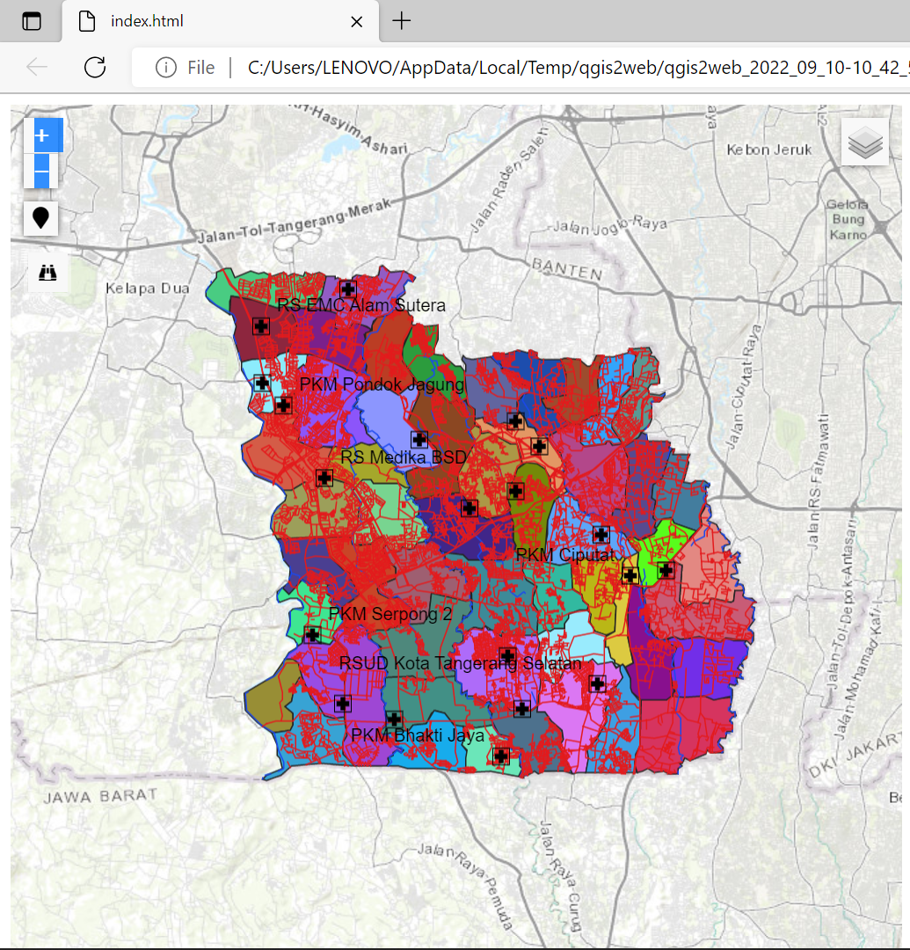
13. See the result by clicking export! DO NOT CLOSE THE WINDOW!

Slide 15
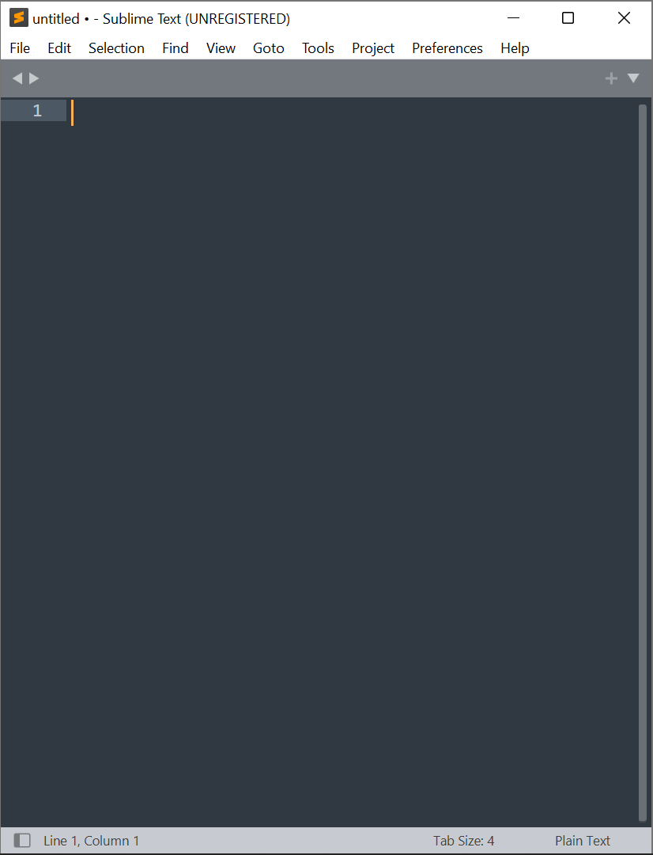
14. Install Sublime Text Build.exe

Slide 16
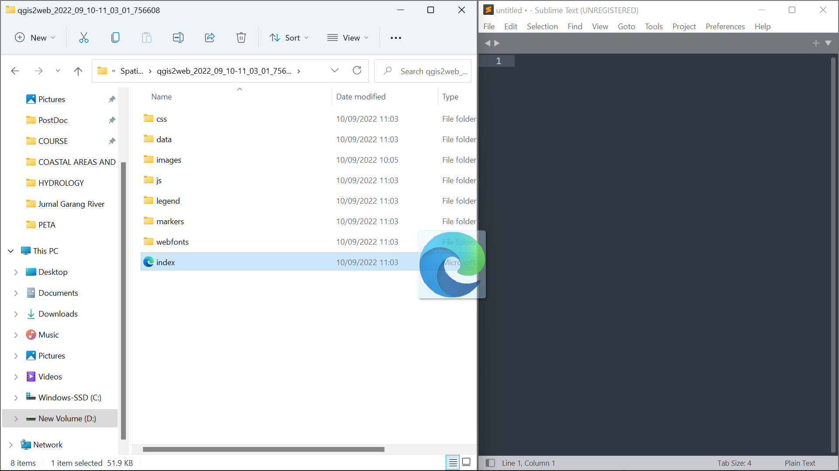
14. Drag the index file from your qgisweb directory to sublime

Slide 17
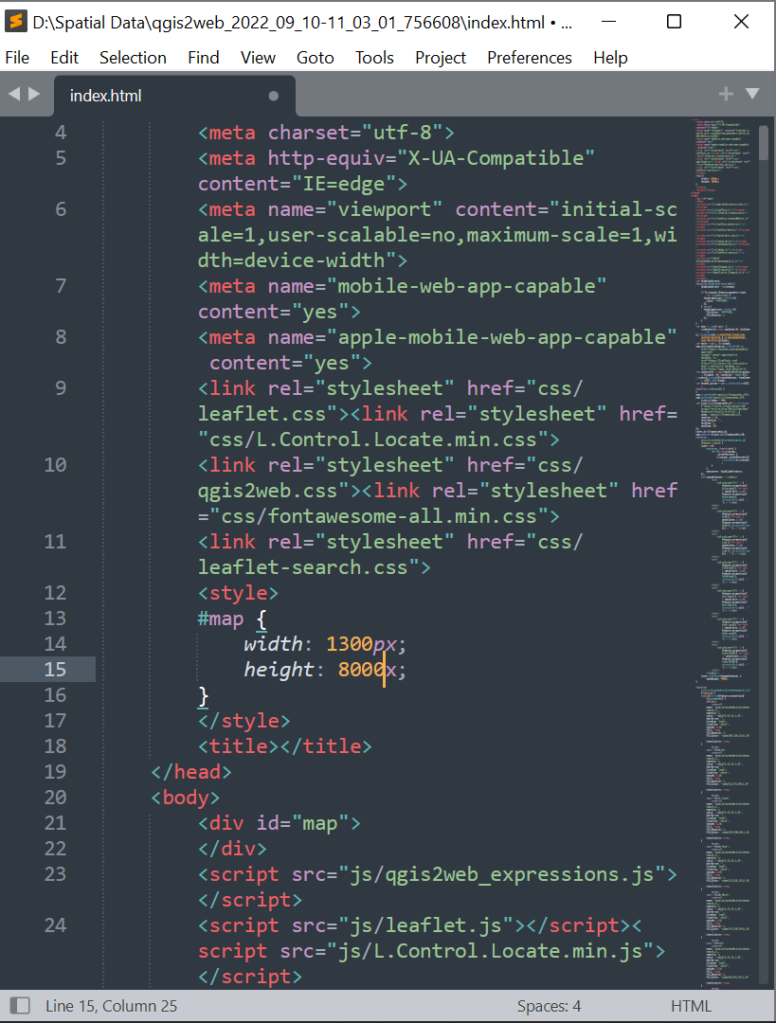
14. Change the map width and height, and do not forget to save it.

Slide 18
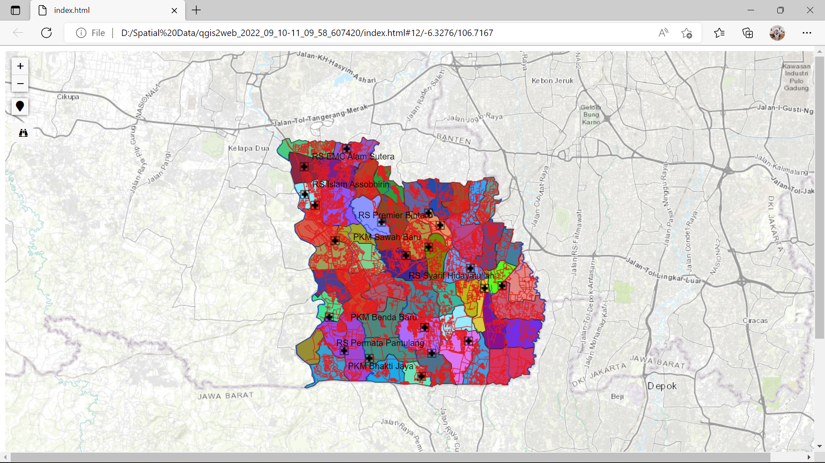
15. You will get wider visualization.

Slide 19
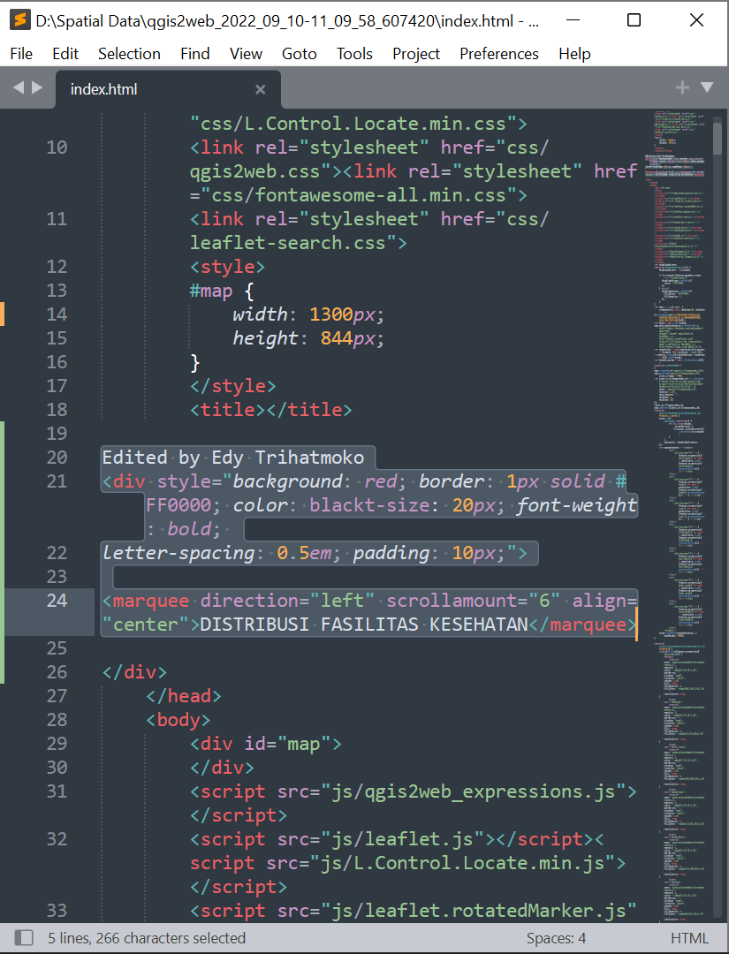
16. Enter under line 18 (</title>
And fill your own title by following the script:
Edited by Edy Trihatmoko
<div style="background: red; border: 1px solid #FF0000; color: blackt-size: 20px; font-weight: bold;
letter-spacing: 0.5em; padding: 10px;">
<marquee direction="left" scrollamount="6" align="center">DISTRIBUSI FASILITAS KESEHATAN</marquee>
DO NOT FORGET TO ALWAYS SAVE YOUR PROGRESS AND CHECK THE BROWSING BY REFRESHING IT.

Slide 20
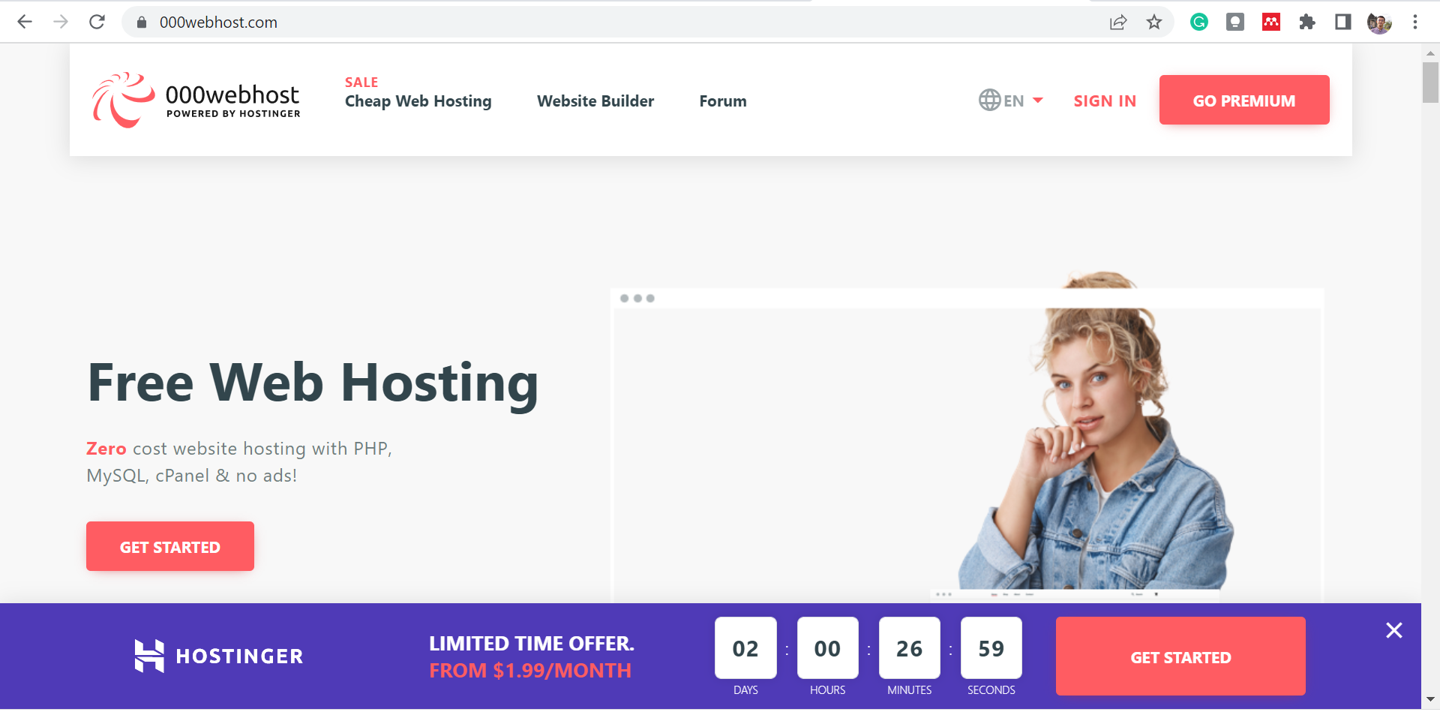
17. Create website hosting, and verify your email.

Slide 21
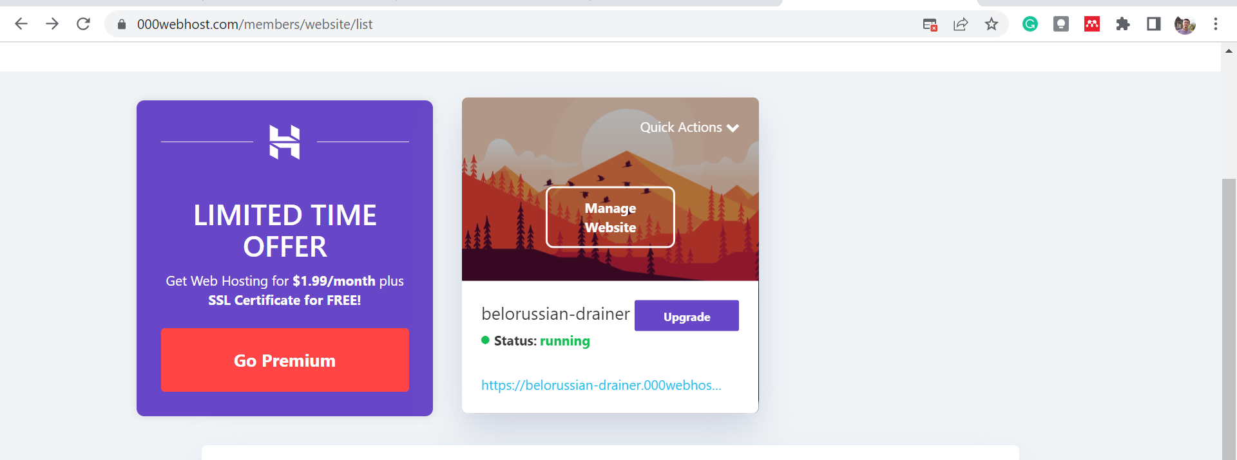
18. Click manage website.

Slide 22
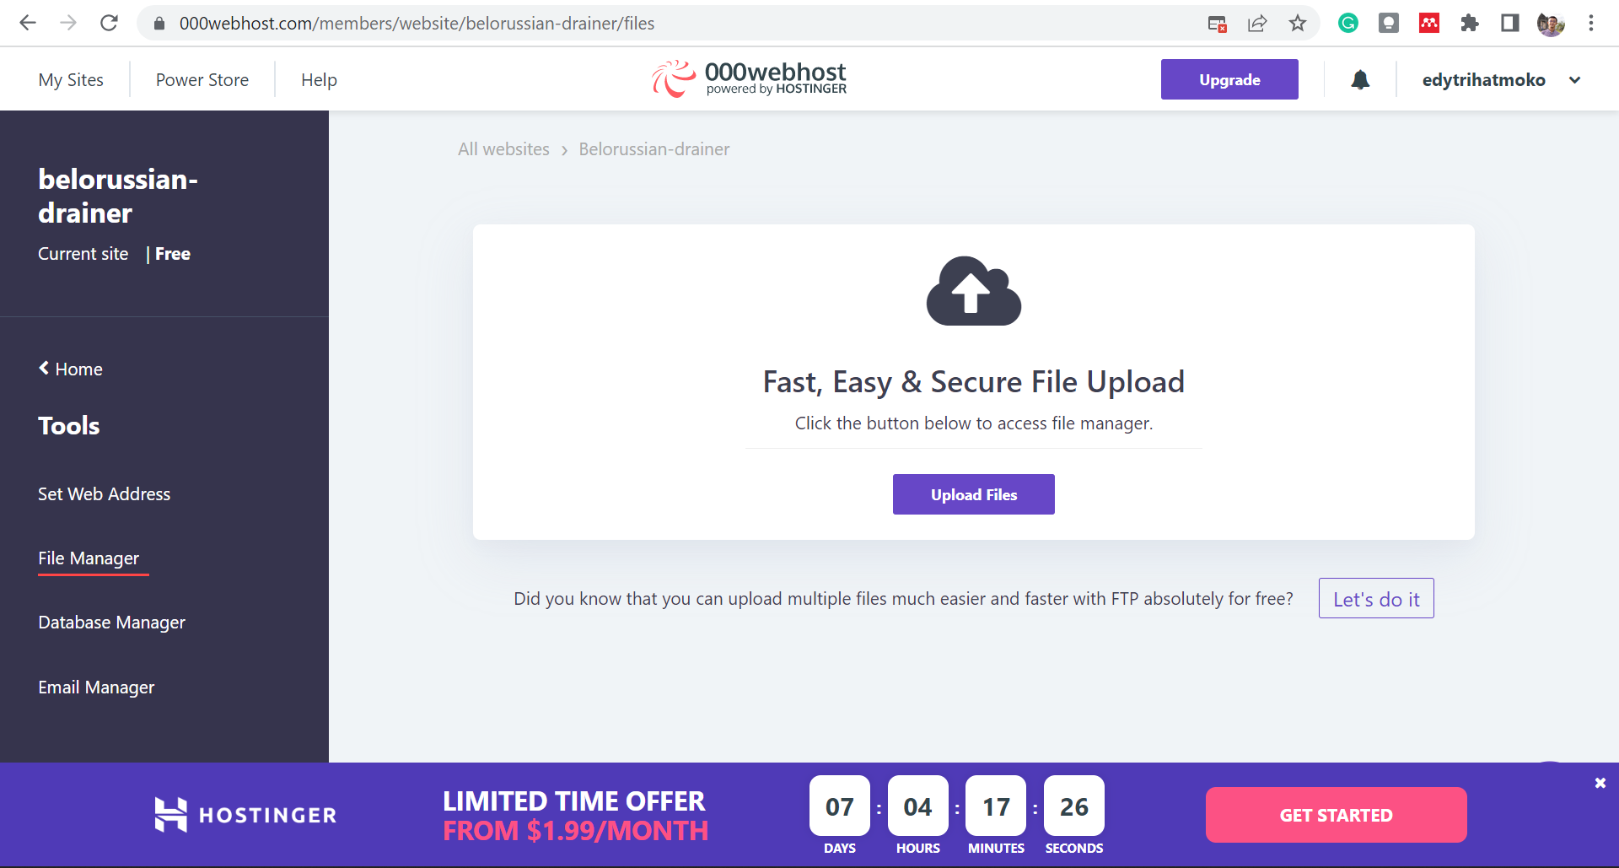
19. Click tools – File Manager – Upload Files

Slide 23
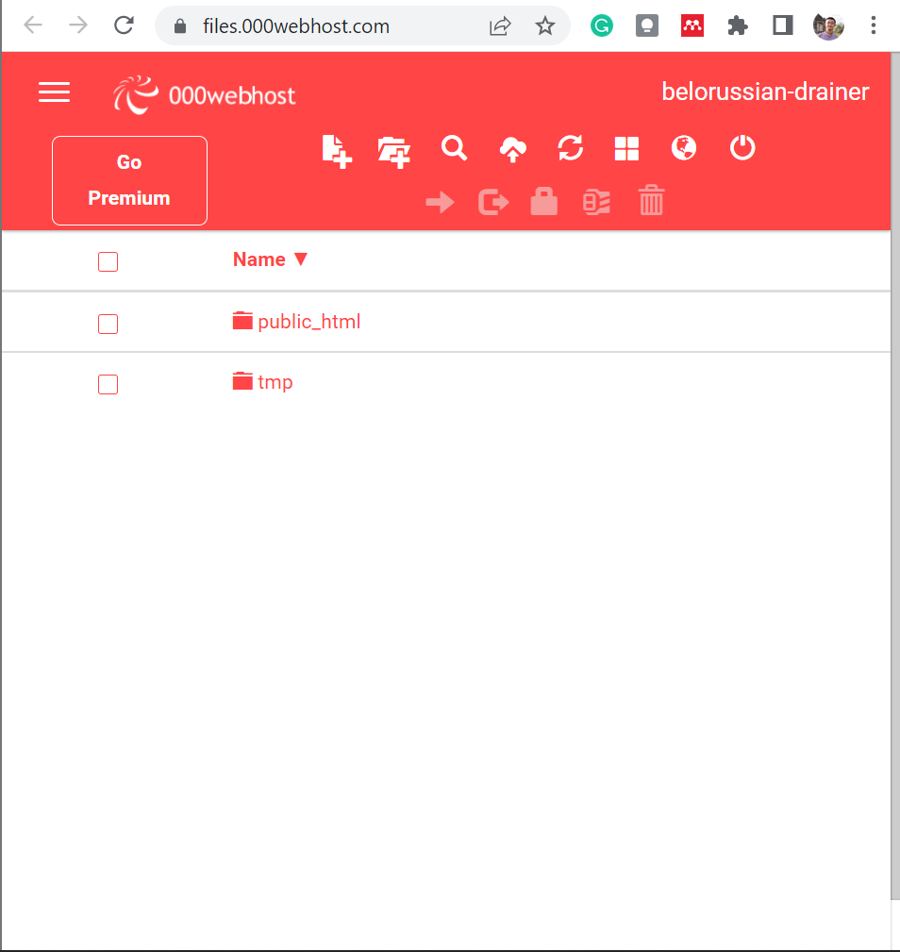
20. Click tools – File Manager – Upload Files – Pblic.html – create new folder

Slide 24
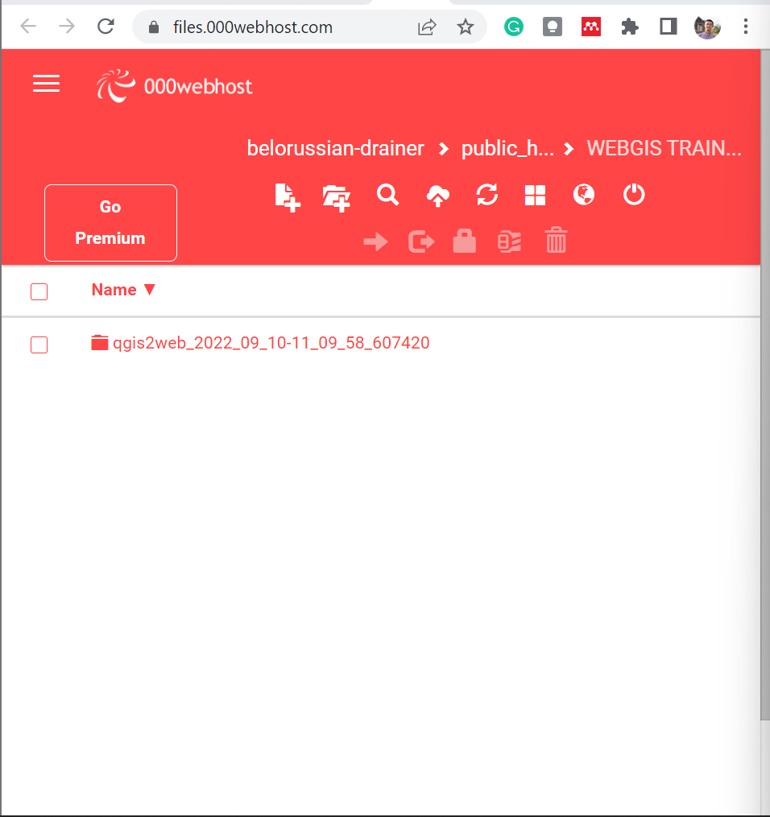
21. Drag your qwebgis file.

Slide 25
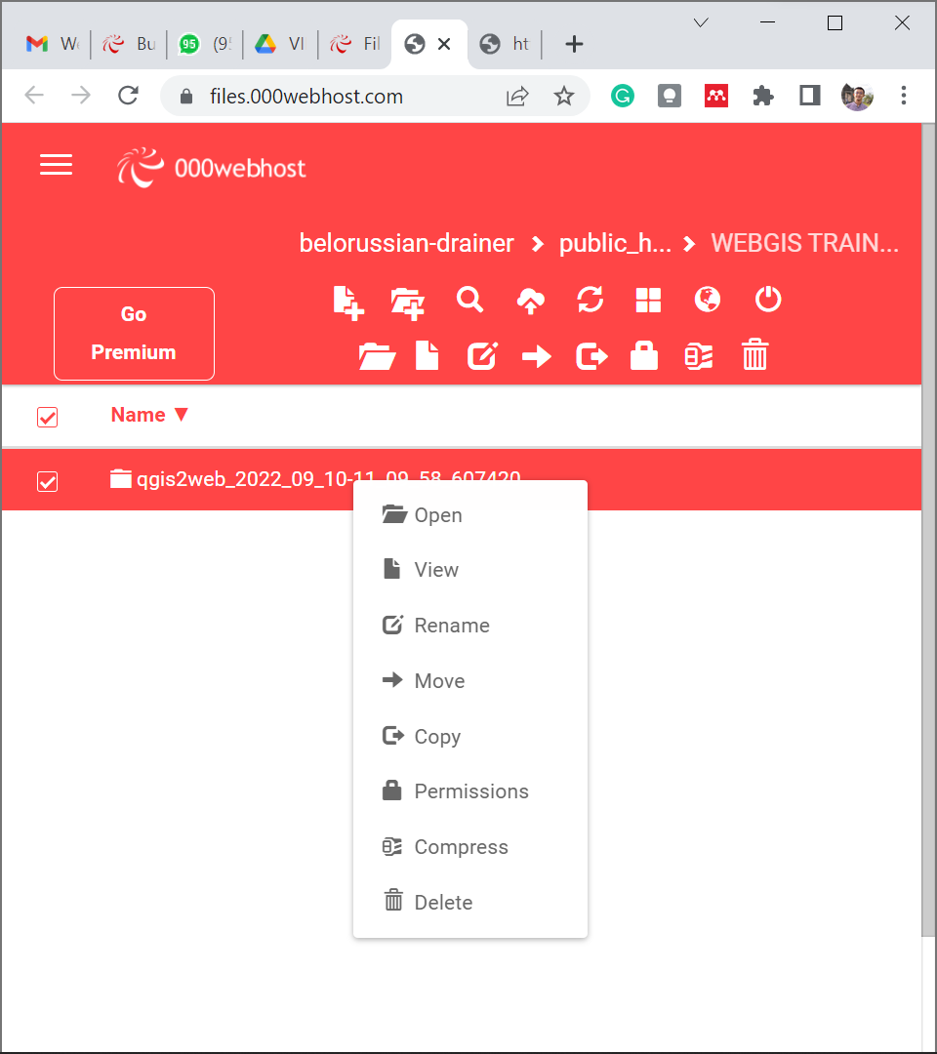
22. When it has uploaded, right-click that file and view.

Slide 26
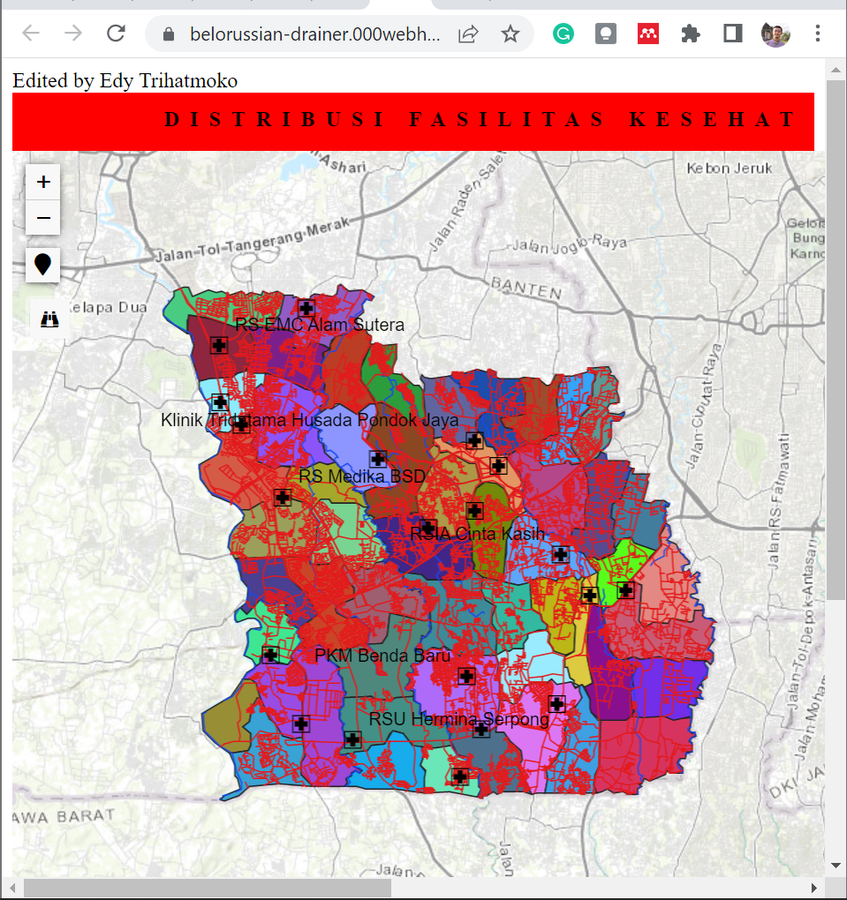
23. See the result (https://belorussian-drainer.000webhostapp.com/WEBGIS%20TRAINING/qgis2web_2022_09_10-11_09_58_607420/#12/-6.3388/106.8225)

